Slide 1
Planning in Artificial Intelligence
Artificial Intelligence – A Modern Approach
Planning Problem
Total Order Planning
Partial Order Planning

Slide 2
What is Planning in AI?
Planning = deciding actions to reach a goal
Initial State → Actions → Goal State
Examples: Trip planning, cooking, going to college

Slide 3
Planning vs Search
Search: finds path between nodes
Planning: finds sequence of actions
Planning = Search in world states

Slide 4
Planning Problem Representation
Planning Problem = (S, A, γ, s0, G)
S: States
A: Actions
γ: Transition model
s0: Initial state
G: Goal state

Slide 5
Components of Planning Problem
Initial State
Goal State
Actions
Transition Model
Plan (solution)

Slide 6
Robot Delivery Example
Initial: Robot in Room A, Box in Room B
Goal: Box in Room A
Actions: Move, Pick, Drop

Slide 7
Action Representation (STRIPS)
Action: Pick(Box)
Preconditions: RobotAt(RoomB), BoxAt(RoomB), HandEmpty
Effects: Holding(Box), NOT HandEmpty

Slide 8
Types of Planning
Total Order Planning
Partial Order Planning

Slide 9
Total Order Planning
Fixed sequence of steps
Also called Linear Planning
Example: Wear socks → Wear shoes

Slide 10
Partial Order Planning
Flexible ordering of steps
Also called Least Commitment Planning
Allows parallel tasks

Slide 11
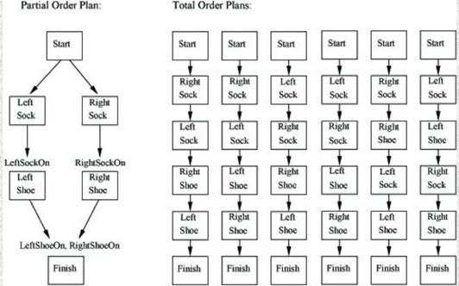

Slide 12
Why Partial Order Planning?
More flexible
Efficient for complex tasks
Closer to real-world planning

Slide 13
Difference
Total Order: fixed sequence, no parallel tasks
Partial Order: flexible, parallel tasks possible

Slide 14
Class Example
Goal: Go to college
Tasks: Eat breakfast, Pack bag, Wear shoes, Wear uniform

Slide 15
Summary
Planning finds sequence of actions
Uses preconditions and effects
Two types: Total Order & Partial Order Planning

